Slide 1
WebRTC Call Debugger
Patrick Feeney

Slide 2
Genesys Cloud and WebRTC Calls
What is Genesys Cloud
No existing tools for past data
Chrome’s webrtc-internals
Manual debugging of call statistics
Special permissions to query New Relic data
Write specific query using SQL-like language
Scroll through manually

Slide 3
Goal
User-friendly dashboard for visualising past call data
Improving the efficiency of Support Engineers.
Don’t waste their time sorting through data.

Slide 4
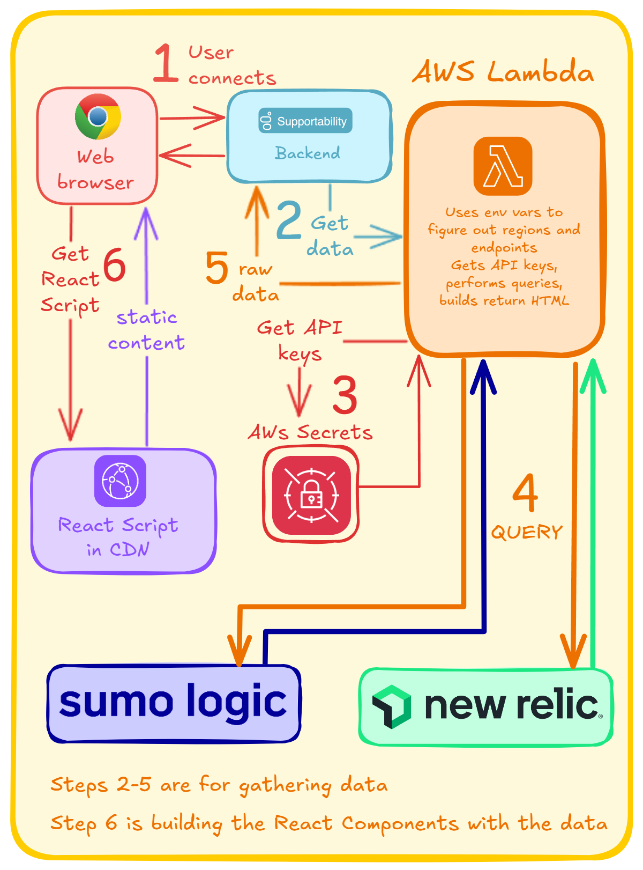
Architecture
Web browser
Supportability
AWS Lambda
AWS Secrets
Sumo Logic
New Relic
React & AWS CDN

Slide 5
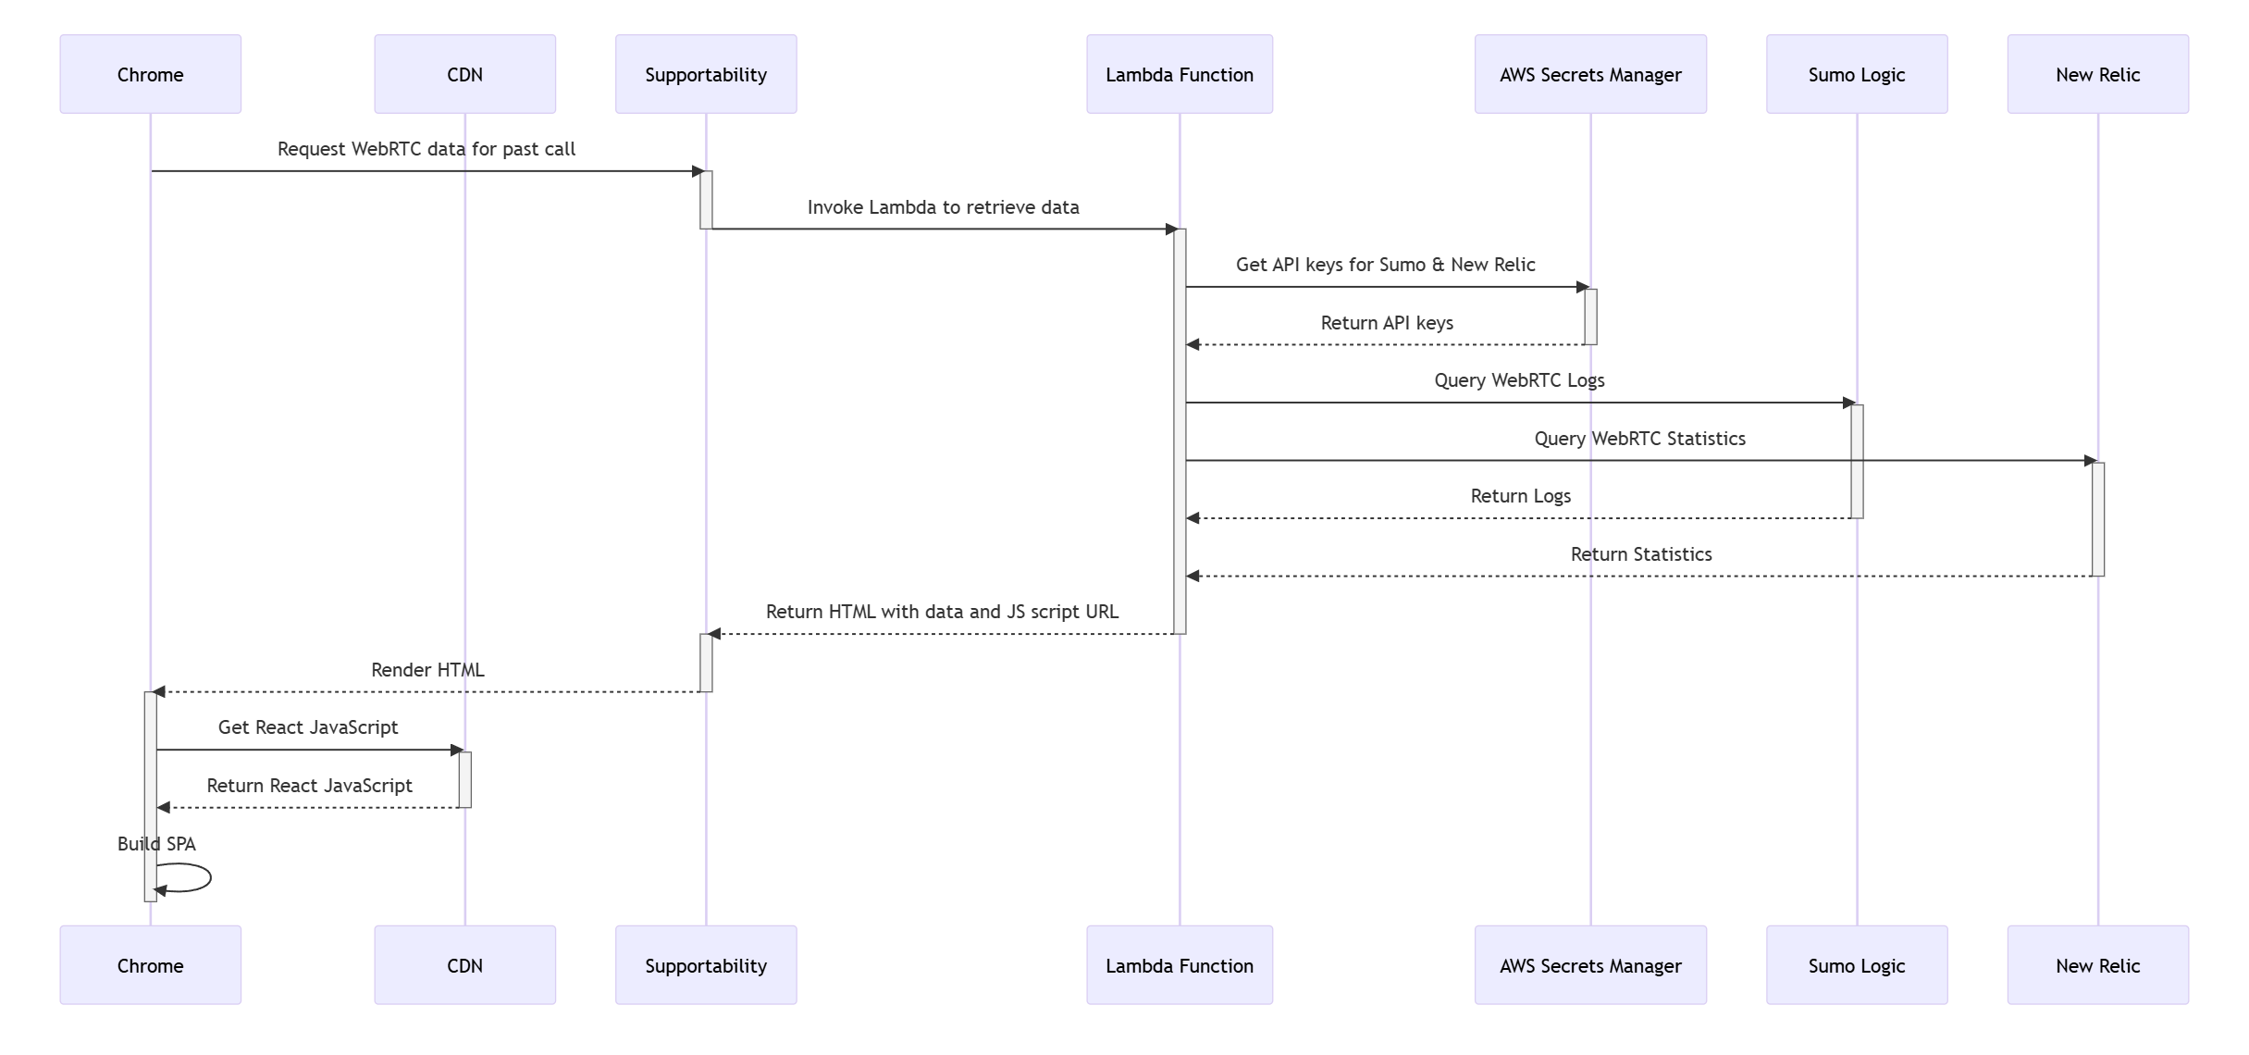
Sequence

Slide 6
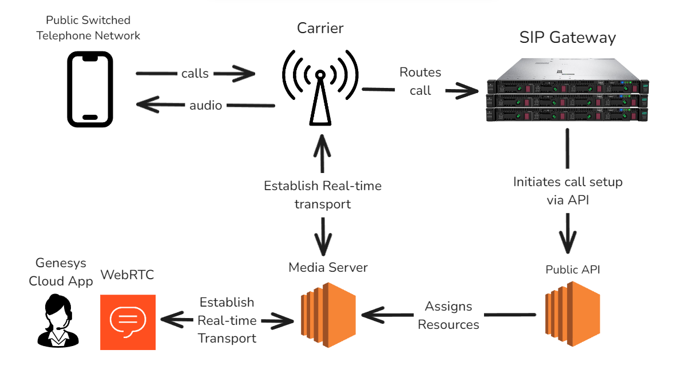
Source of the data to plot

Slide 7
DEMO
Querying call data from Lambda
Visualising metrics as Charts
Interactive Chart selection
Hover Effect to correlate metrics between Charts
Handling multiple Charts with Progressive Loading

Slide 8
Deep Dive
Hover Effect
Progressive load

Slide 9
Learning Outcomes
React
Hooks
HTML DOM
JavaScript
Queues & Async Behaviour
TypeScript
JSON manipulation
Amazon Web Services
Lambda
Secrets Manager
Genesys Call Infrastructure

Slide 10
Conclusion
Sumo Logic and New Relic data in a single website
More efficient way to analyse data from previous calls
Professional environment

